Slide 1
BIO 350 Lab #1 Schedule
Submit proof of online safety quiz to TA
Bio 350 lab safety overview (Room 202 specific)
Attendance by clickers
Introduction to electric currents in aqueous solutions, Ohm’s Law, and bread boards
Complete bread board lab and calculations
Lab reports submitted via Safe Assign by Wed Sept 7, 5 PM

Slide 2
Clicker Attendance Lab #1 Which set of letters best completes the word: V_L_A_E
U F C
E H X
H V U
G T O

Slide 3
Electric currents in aqueous solutions, Ohm’s Law, and bread boards
Text pages 49-51

Slide 4
Charged molecules

Slide 5
Current: Flow of Ions in Aqueous Solutions

Slide 6
Measurements of Ion Movement
Ohm’s Law I = V/R
I = current
in amperes (A)
flow of charges through a solution
V = voltage
in volts (V)
represents the charge difference between two points
R = resistance
in ohms (Ω)
opposes passage of charges

Slide 7
Influences on Current
X-sec area
Distance to travel
Availability of charge carriers (ions)

Slide 8
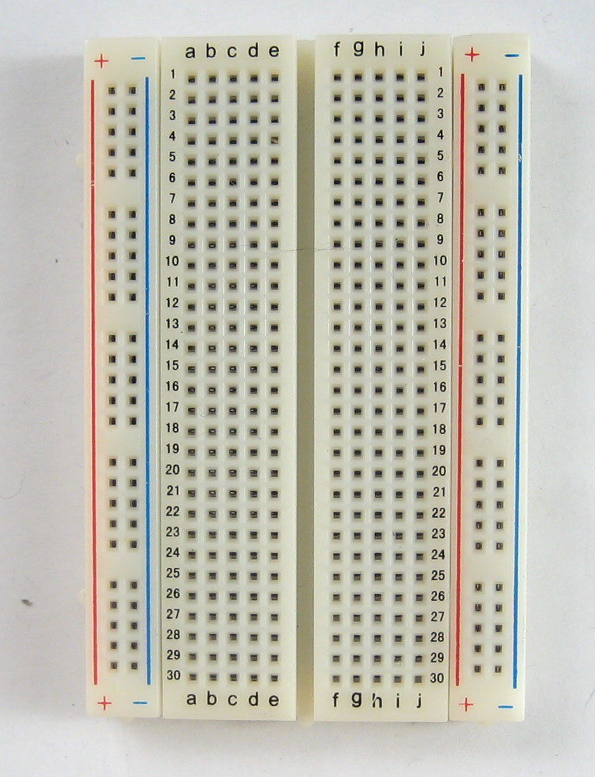
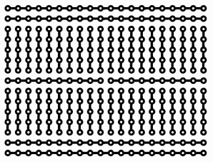
Breadboards
Modeling movement of charges with metal instead of aqueous solutions

Slide 9
Movement of charges

Slide 10
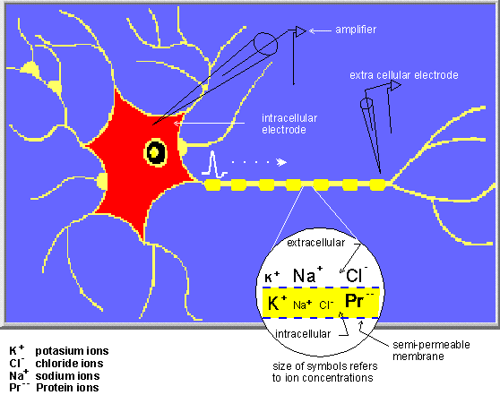
Why bother? Current in physiological systems

